Slide 1
Management of Inbreeding and Genetic Variation in Livestock
Dr. John B. Cole
PLS 225 | March 13, 2025

Slide 2
Topics for discussion
A few points about genetic improvement
Inbreeding is different things to different people
New inbreeding matters more than old inbreeding
Inbreeding affects different traits in different ways
Nobody agrees what to do about it
Some thoughts on genetic defects
Conclusion

Slide 3
A few points about genetic improvement

Slide 4
What is the value of genetic selection?
Since 1957, management (dark blue) was 28% of gains, and genetics (light blue) was 71% of gains

Slide 5
Farmers drive genetic improvement
New York
360,783
Minnesota
204,077
Wisconsin
687,737
Pennsylvania
283,390
California
866,259
Texas
262,205
States with >200,000 DHI cows (01/2025)

Slide 6
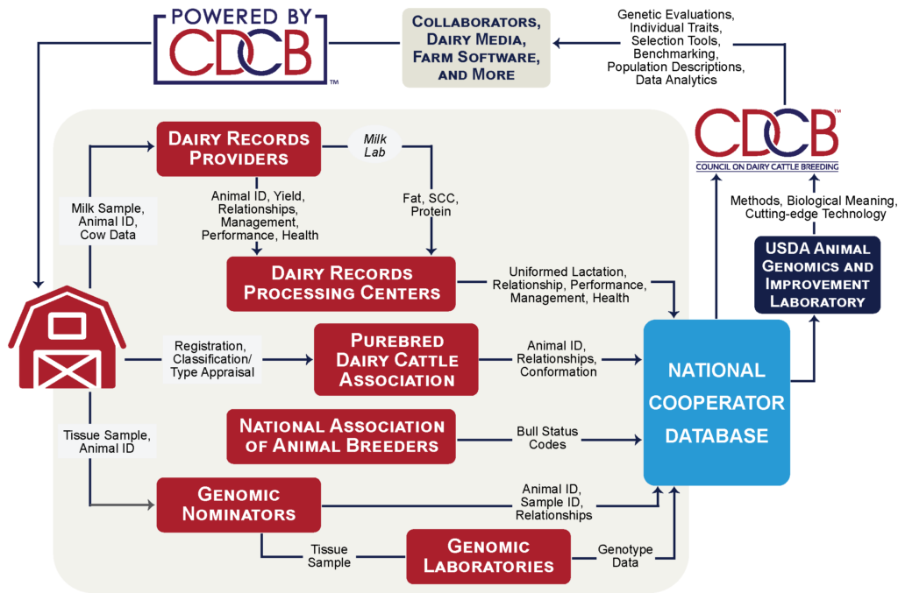
Where do dairy data come from?

Slide 7
Inbreeding is different things to different people

Slide 8
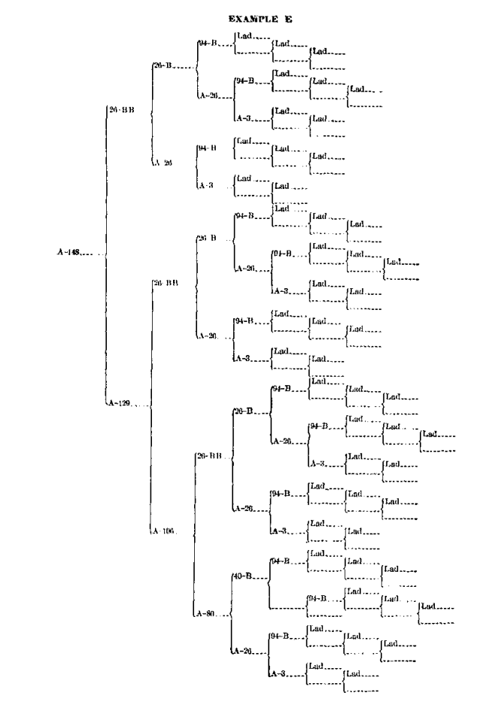
Inbreeding results from the mating of related animals
Cow A-148
f_{P} = 0.646
It’s the proportion of the genome that is identical because it came from the same ancestor
Inbreeding results when related animals are mated to one another
Inbreeding is inevitable in a finite population
It can be managed, but not avoided
Source: Swett et al. (1949)

Slide 9
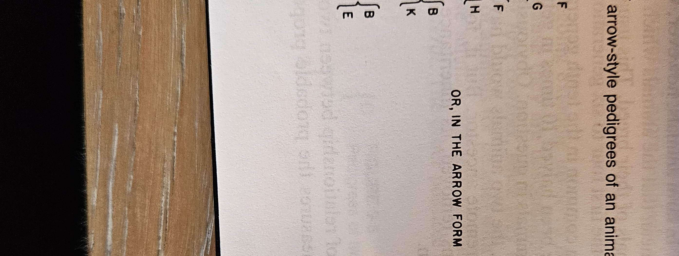
Pedigree inbreeding
Assumes each parent transmits ½ of their genome to their offspring, each grandparent ¼, etc.
Proportion of alleles identical by descent from a common ancestor
Legates and Warwick (1990)

Slide 10
Genomic inbreeding
It’s the proportion of homozygous alleles in an individual’s genome
It combines identity-by-descent with identity-in-state
Aerostar
Megastar
Aerostar
Chromosome 24

Slide 11
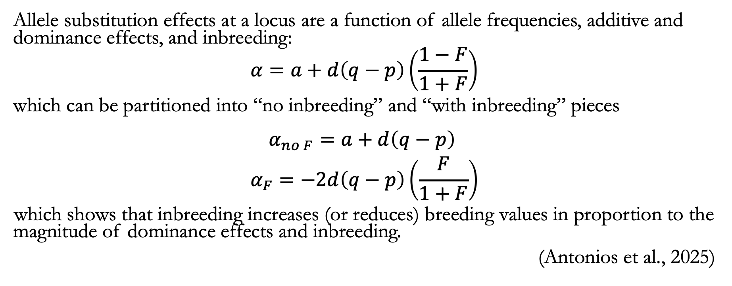
Inbreeding reflects dominance effects
Allele substitution effects at a locus are a function of allele frequencies, additive and dominance effects, and inbreeding:
$$α=a+d\left(q−p\right)\left(\frac{1−F}{1+F}\right)$$
which can be partitioned into “no inbreeding” and “with inbreeding” pieces
$$\begin{matrix}α_{no F}=a+d\left(q−p\right) \\ α_{F}=−2d\left(q−p\right)\left(\frac{F}{1+F}\right)\end{matrix}$$
which shows that inbreeding increases (or reduces) breeding values in proportion to the magnitude of dominance effects and inbreeding.
(Antonios et al., 2025)

Slide 12
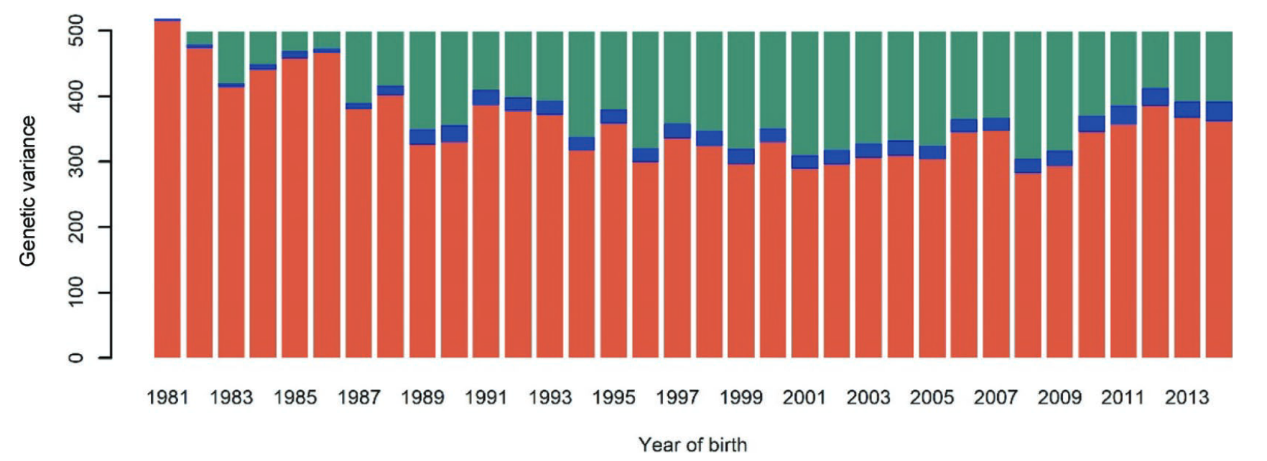
Increased coancestry reduces genetic variance
Macedo et al. (2021)
Red = observed genetic variance; blue = loss of genetic variance due to drift; green = loss of genetic variance due to selection.

Slide 13
What aspects of selection favor inbreeding?
Multiple generations of intense directional selection (Robertson, 1961)
High variance of reproductive success across individuals due to the use of advanced reproductive technologies (Nicholas and Smith, 1983)
Use of BLUP-based genetic evaluations in combination with truncation selection (Verrier et al., 1993)
These result in widespread use of related individuals as parents of the next generation (e.g., Howard et al., 2017)

Slide 14
Inbreeding often has undesirable effects
Harmful loci increase in frequency and are
more likely to be paired-up
  e.g., Haplotypes such as HH1
  Probably accounts for most inbreeding depression
Slow inbreeding is more effective at selecting against harmful loci
Undesirable loci travel along with desirable loci if they’re close together (“hitchhiking”)

Slide 15
Sometimes, inbreeding is deliberate
Terminal crosses in livestock
  This is very common in, e.g., poultry and swine breeding
Inbred lines in crop breeding
  e.g., maize and wheat
Species in which fixation of phenotypic characteristics are more important than performance
Horses

Slide 16
New inbreeding matters more than old inbreeding

Slide 17
US Holstein cattle (proven genotyped bulls)
Source: CDCB (2024)

Slide 18
PINE-TREE ACURA-ET (029HO18960)
HOUSA000139005002 2007-09-17 COYNE-FARMS DORCY-ET 1 58k
HO840003006972816 2010-06-22 MOUNTFIELD SSI DCY MOGUL-ET 1 58k
HOUSA000062784081 2006-04-23 MOUNTFIELD MARSH MAXINE-ET 1 58k
HOUSA000072254526 2013-01-05 WOODCREST MOGUL YODER-ET 8 77k
HOUSA000060597003 2003-03-03 ENSENADA TABOO PLANET-ET 4 778k
HO840003008363689 2011-03-21 WOODCREST PLANET YAKARA-ET 3 3k
HOUSA000066893887 2009-05-18 COYNE-FARMS BKEYE YVONNE-ET 1 58k
HO840003128557482 2015-11-15 ABS ACHIEVER-ET 17 140k
HOUSA000060996956 2004-10-31 BADGER-BLUFF FANNY FREDDIE 1 58k
HONLD000543756297 2011-06-16 APINA ALTAEMBASSY-ET 2 58k
HOUSA000064969166 2008-12-01 STRAUSSDALE PLANET ELLA 1 58k
HO840003013177242 2013-09-30 COMPASS-TRT AMRC AE J925-ET 8 77k
HOUSA000064966739 2008-12-23 ROYLANE SOCRA ROBUST-ET 1 58k
HOUSA000070640281 2011-07-26 SEAGULL-BAY MISS AMERICA-ET 2 58k
HOUSA000066228178 2009-04-16 AMMON-PEACHEY SHAUNA-ET 1 58k
HO840003142332520 2017-11-25 PINE-TREE ACURA-ET 17 140k
HOUSA000069398748 2010-06-30 MOUNTFIELD MSY MAURICE-ET 2 58k
HO840003009554583 2012-05-22 S-S-I MAURICE PARTYROCK-ET 2 58k
HO840003006972817 2010-06-22 JK-GOLD SSI DORCYPIE7042-ET 1 58k
HO840003014334961 2014-01-01 S-S-I PARTYROCK PROFIT-ET 8 77k
HO840003006972816 2010-06-22 MOUNTFIELD SSI DCY MOGUL-ET 1 58k
HO840003009554577 2012-05-17 S-S-I MOGUL MAHO 8054-ET 7 9k
HO840003004672693 2010-08-26 S-S-I ROBUST MAHO 7083-ET 2 58k
HO840003132116871 2016-03-13 PINE-TREE 9882 PROF 7019-ET 20 19k
HOUSA000064966739 2008-12-23 ROYLANE SOCRA ROBUST-ET 1 58k
HOUSA000069981349 2010-12-28 SEAGULL-BAY SUPERSIRE-ET 2 58k
HOUSA000066228178 2009-04-16 AMMON-PEACHEY SHAUNA-ET 1 58k
HO840003011890130 2013-12-02 OCD SUPERSIRE 9882-ET 17 140k
HOUSA000064966739 2008-12-23 ROYLANE SOCRA ROBUST-ET 1 58k
HO840003008315320 2011-03-08 OCD ROBUST SHIMMER-ET 2 58k
HOUSA000066228180 2009-04-18 AMMON-PEACHEY SHANA-ET 1 58k
f_{P} | 12.8
f_{G} | 15.3
NM$ | 1, 115
TPI | 3,006

Slide 19
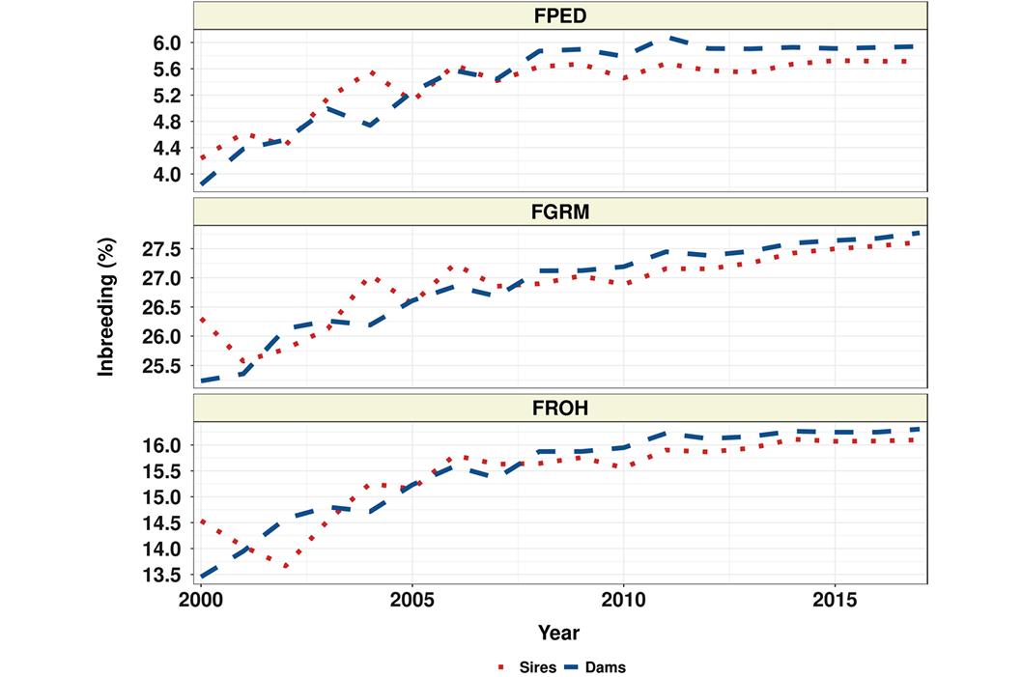
US Angus cattle
Source: Lozada-Soto et al. (2021)

Slide 20
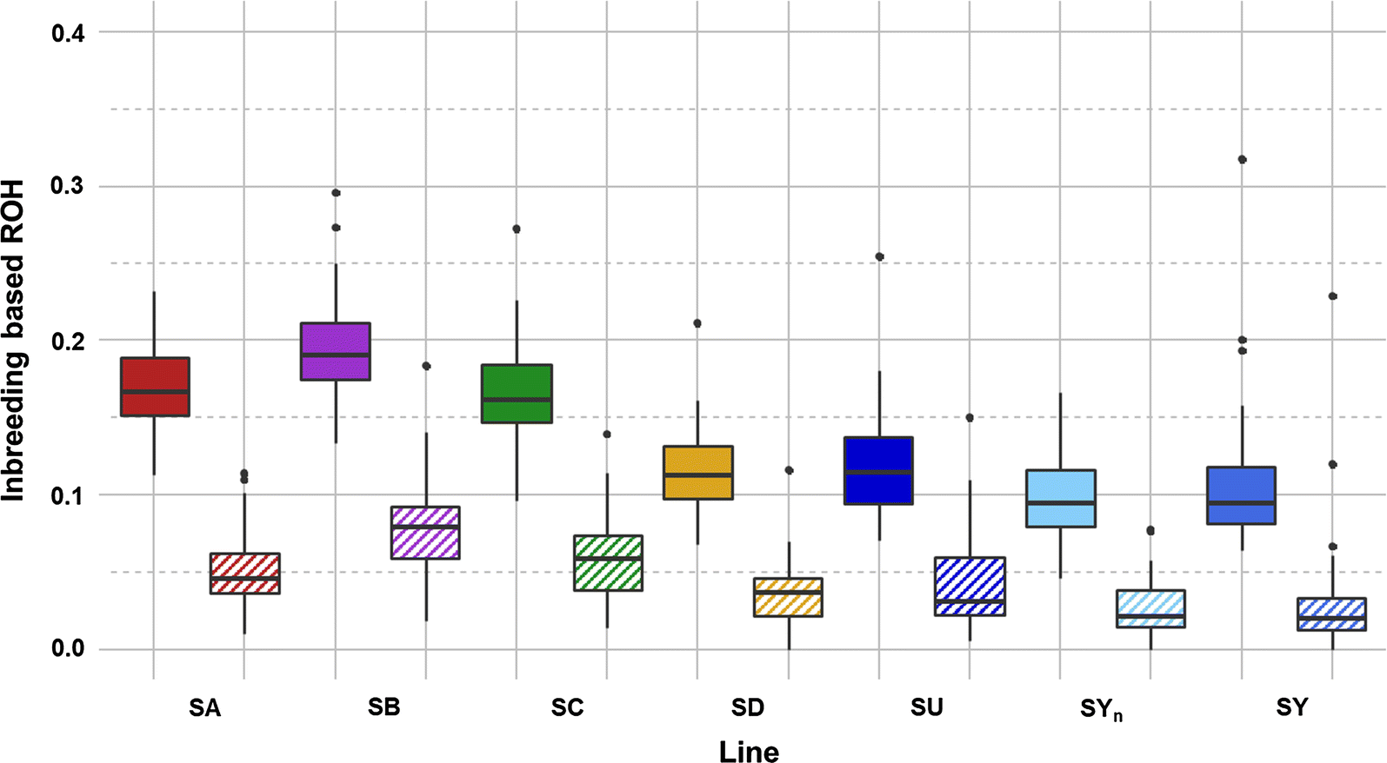
Commercial rainbow trout lines
Box plots of total inbreeding (FROH) and recent inbreeding (FROH>10) for each rainbow trout line.
Plain box: total inbreeding (FROH).
Hatched box: recent inbreeding (FROH>10).
Source: D’Ambrosio et al. (2019)

Slide 21
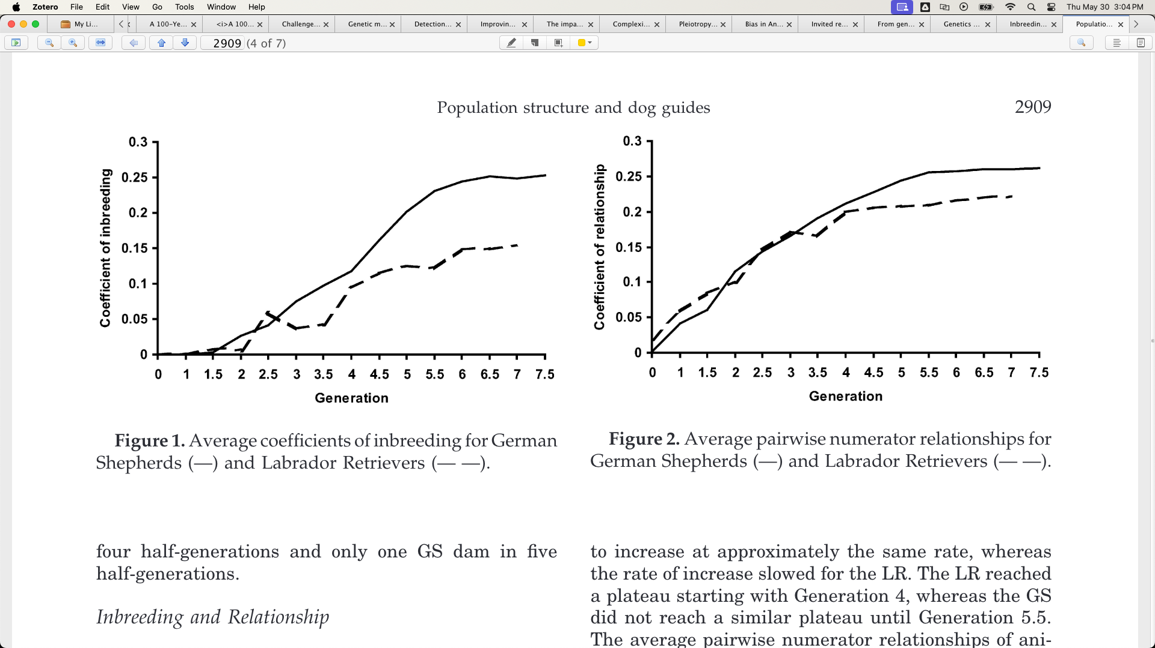
Working dogs
Source: Cole et al. (2004)

Slide 22
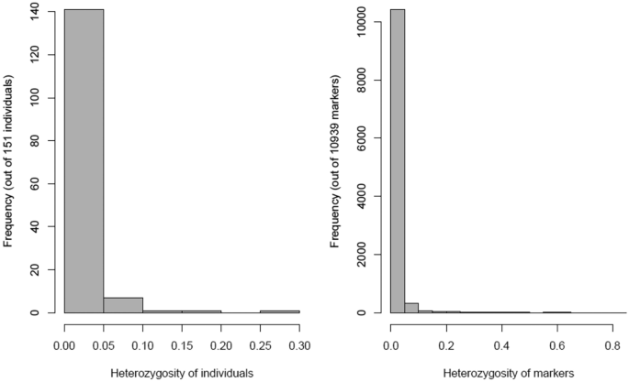
Tropical maize lines
Ayesiga et al. (2022)

Slide 23
Inbreeding affects different traits in different ways

Slide 24
We don’t know how much is too much
Selection is now on indices that include health and fitness data
This avoids past mistakes from focusing on only one or a few traits
Will we see genetic merit gradually decrease, or will we cross a threshold and see a sudden crash?
Interviewer: “How did you go bankrupt?”
Ernest Hemingway: “Two ways. Gradually, then suddenly.”
Correlation: -0.23.
Source: CDCB (2019).

Slide 25

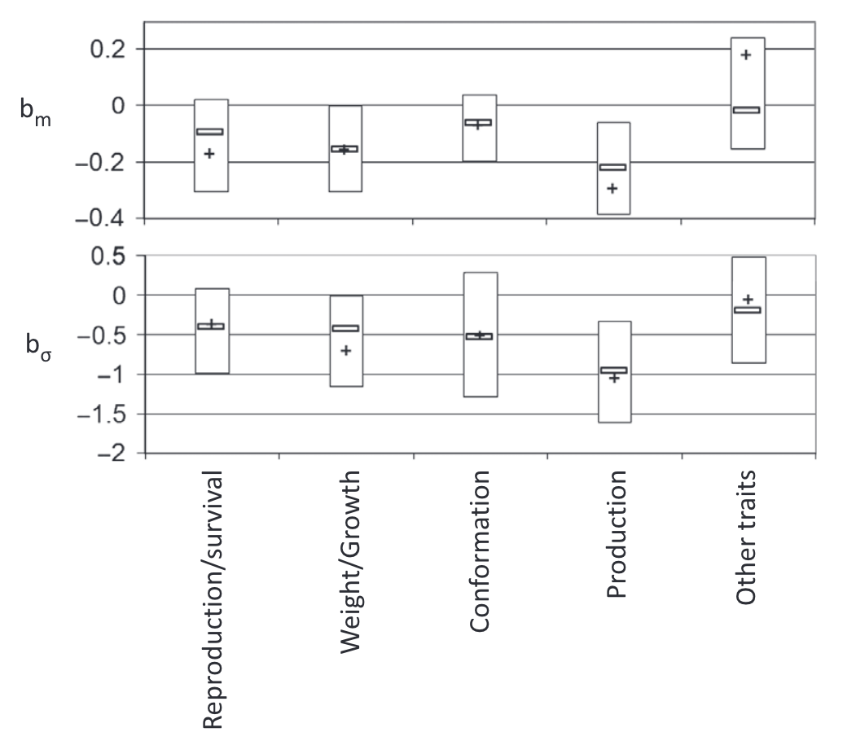
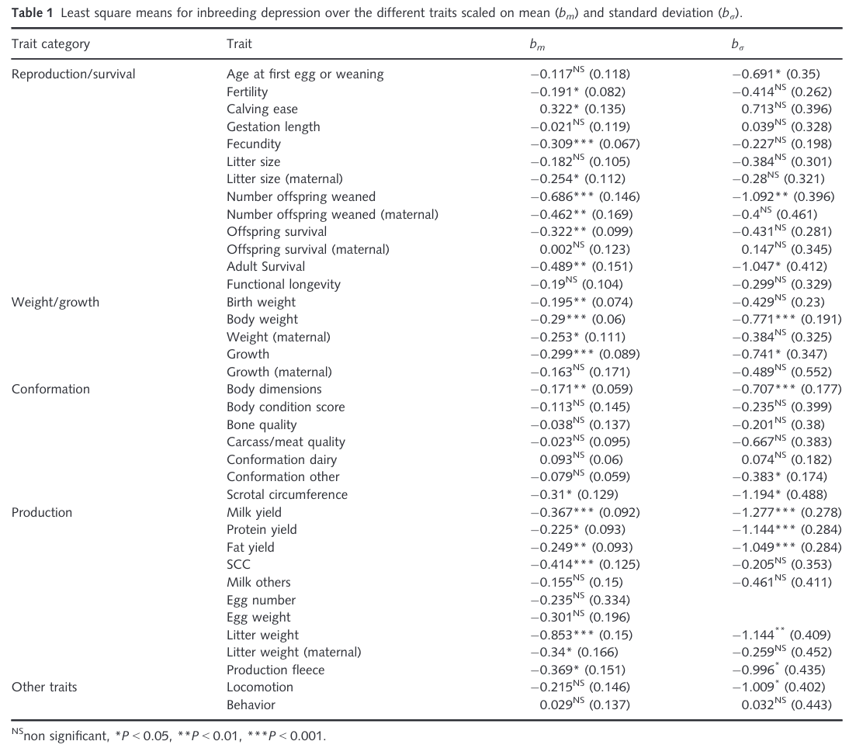
Inbreeding can be depressing
Source: Leroy (2014)

Slide 26
Should dairy farmers worry about inbreeding?
Change in phenotypic performance per 1% (0.25%) increase in inbreeding
Milk | Fat | Protein | PL | SCS | DPR | HCR | CCR | LIV
-73.6 | -2.70 | -2.10 | -0.28 | 0.01 | -0.22 | -0.22 | -0.31 | -0.11
-18.4 | -0.67 | -0.52 | -0.07 | 0.0025 | -0.05 | -0.05 | -0.08 | -0.03
Source: CDCB (https://webconnect.uscdcb.com/#/summary-stats/breed-means-bases-heterosis-inbreeding-regressions).
Change in genetic potential per year when selecting on NM$
Milk | Fat | Protein | PL | SCS | DPR | HCR | CCR | LIV
+126.9 | +7.7 | +4.4 | +0.49 | -0.02 | +0.03 | +0.15 | +0.15 | +0.25
Source: AGIL, ARS, USDA (https://www.ars.usda.gov/ARSUserFiles/80420530/Publications/ARR/nmcalc-2021_ARR-NM8.pdf).

Slide 27
Nobody agrees on what to do about it

Slide 28
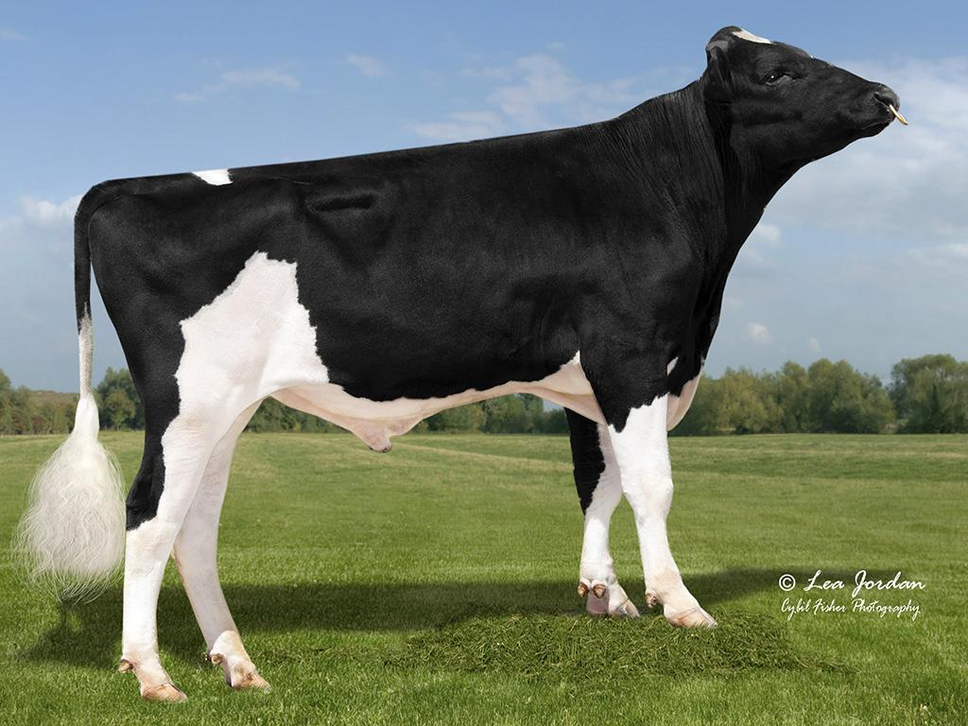
We can adjust PTAs to account for inbreeding
Penalize bulls whose daughters
are more related to the breed?
Use genomic rather than pedigree
inbreeding?
The US does both!
Limit active bulls from the same sire family?
What about embryo donors?
Source: Alta Genetics

Slide 29
We can trim pedigrees?
Inbreeding melts away with the
touch of a button!
Reflects the biological impact of new
versus old inbreeding
Some countries already do this
  Italy (4), Slovak Republic (3), UK (5)
  Some countries have more recent
  “founder” years

Slide 30
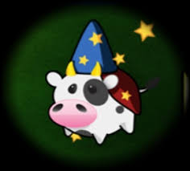
What if we don’t publish PTAs?
To avoid overuse of bulls, no PTA
will be published
Bulls will be mated at random to cows
Or, bulls can receive “red”, “yellow”, or “green” badges to indicate trait quality
Or, only the mate selection software knows the PTA

Slide 31
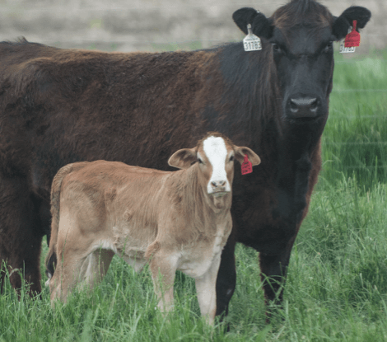
We could use terminal dairy embryos?
Instead of selling semen, we could sell
embryos which represent the ideal terminal
dairy cross
There would be no inbreeding!
Who will maintain the needed purebred lines?
Is the cost of creating and transferring these embryos manageable?

Slide 32
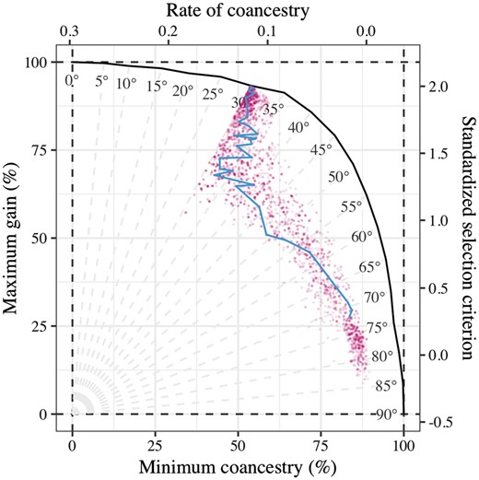
We can change the index
Add some measure of genetic
diversity to selection indices
A possible opportunity to use
subpopulation membership
Isn’t this just a less-efficient way of implementing optimal contribution theory,
which we’ve all been carefully ignoring?

Slide 33
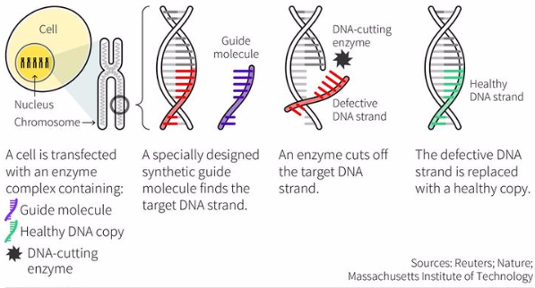
Gene editing might be the solution
What if we just use gene editing to “fix” defects when we find them (Johnsson et al., 2019)?
  You only lose a few months with surrogate sires!
We can get rapid genetic
gain without consequences!
Do we know where it’s
important to have diversity?

Slide 34
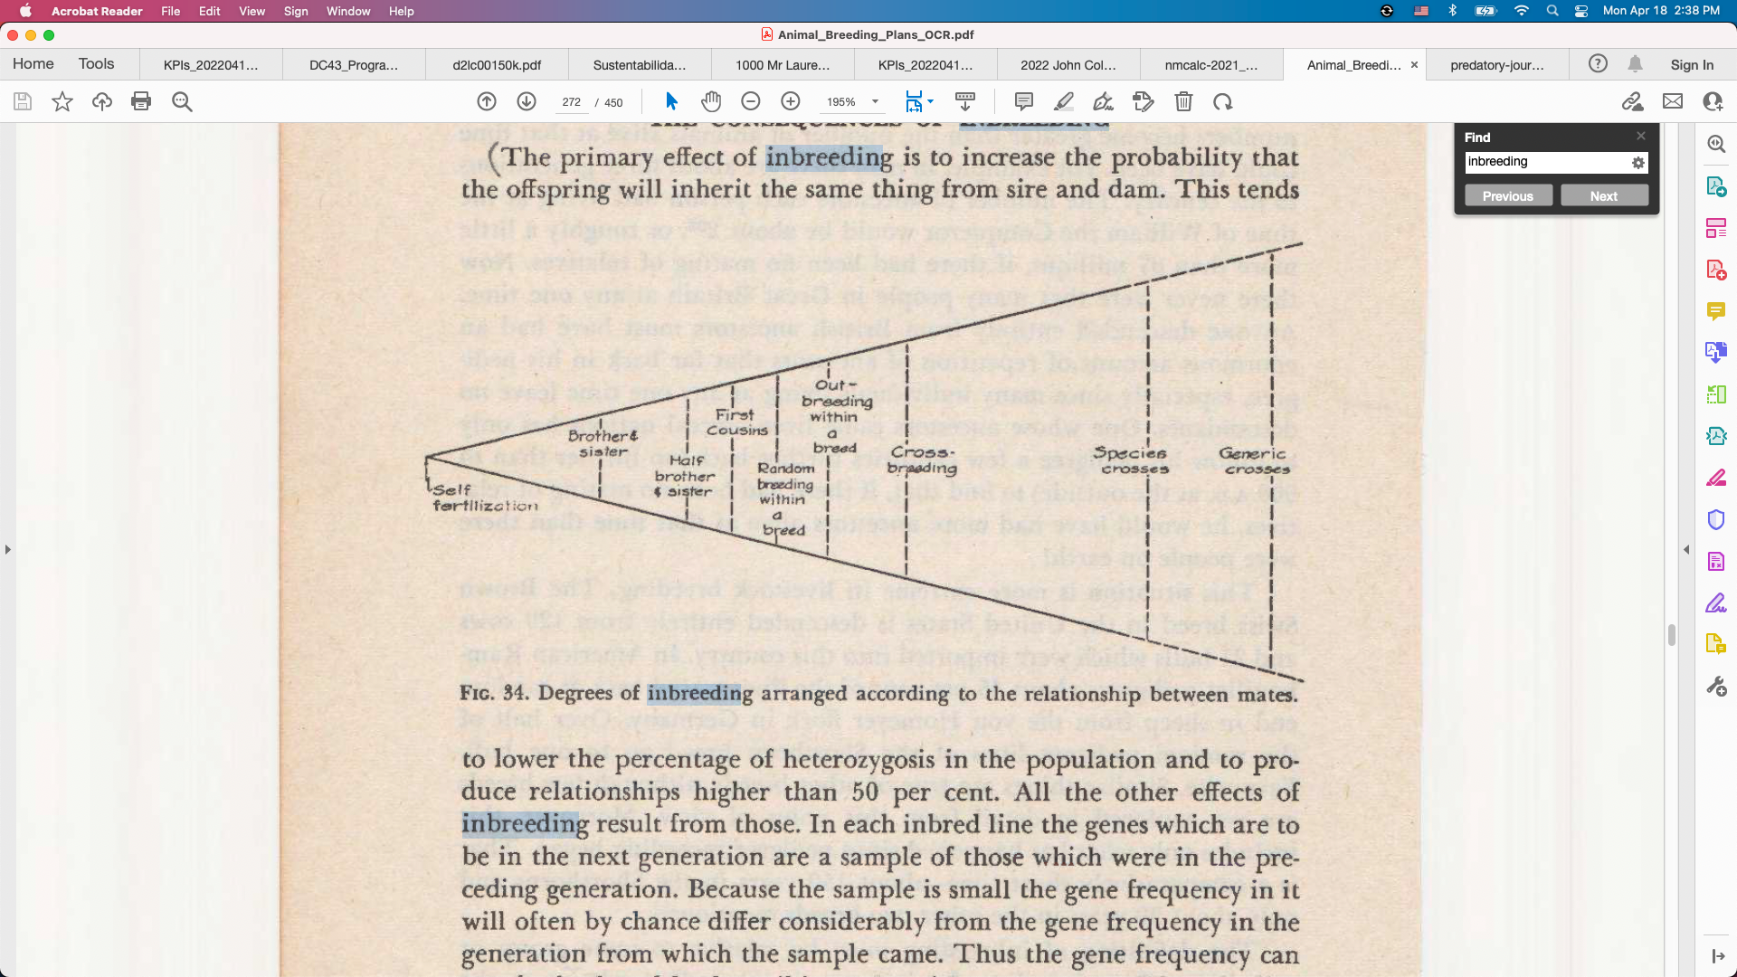
We can outcross between studs
AIs are creating sub-populations
within breeds because of genetic
protection programs
  Will this lead to rotational breeding from each
  stud in turn?
How much difference should we expect if we’re all using similar breeding objectives?
Source: Lush (1945)

Slide 35
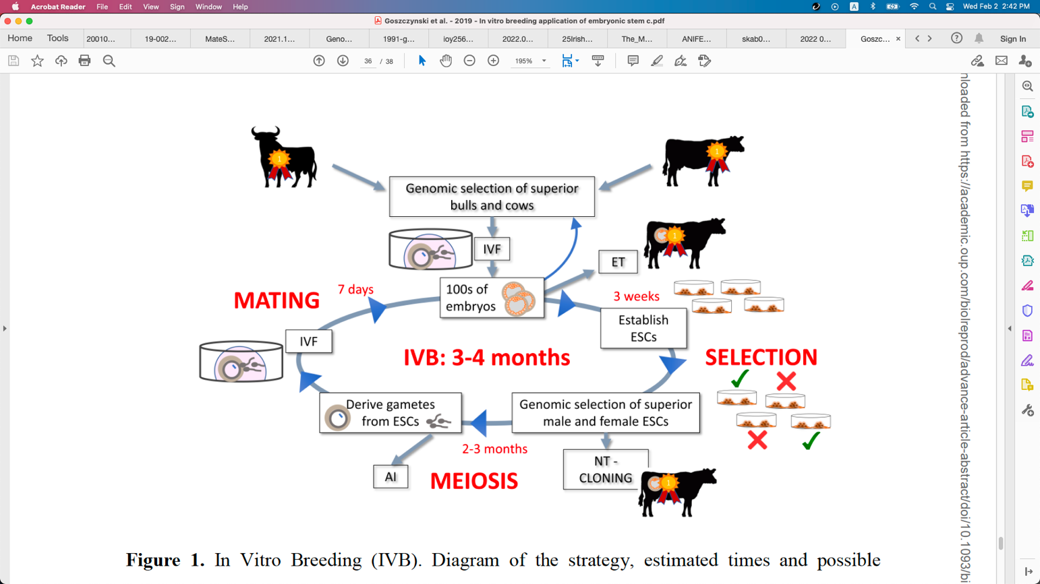
Will in vitro breeding ever work?
Embryonic stem cells can be turned into sperm and eggs and used to create a new generation of embryos (Goszczynski et al., 2018)
Faster genetic gain because less
time is needed to create the next
generation
Live animals eventually needed

Slide 36
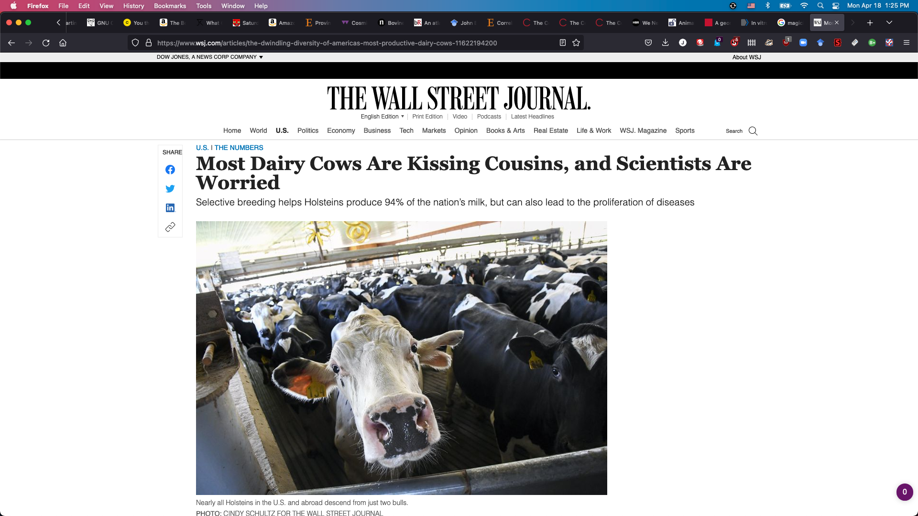
Will we retain license to operate?
Inbreeding may impact our
social license more than
production economics
People don’t understand
the selection on performance
practiced by livestock farmers
What will consumers, retailers, and bankers demand?

Slide 37
Am I serious about this?
Genetic evaluation is a tool for ranking animals for selection, not managing genetic diversity
  We can favor “outcross” animals, if we can find them, and penalize “inbred” animals
  Such adjustments lack theoretical justification and can’t achieve what we want them to
Would we rather pretend we’re doing things, or make changes that have real impacts (Cole, 2024)?

Slide 38
Are there better solutions to this problem?
Some ways to avoid inbreeding
Optimal contribution theory
Minimization of progeny inbreeding
Linear programming
Look-ahead mate selection
Selection against lethal alleles
Index selection including Mendelian sampling variance
Genomic selection including dominance
There are many theoretically
satisfying ideas nobody uses
Geneticists and AI staff don’t
breed cows, farmers do
Many cows are now mated
at random to a portfolio of bulls
Everyone’s neighbor should use different bulls

Slide 39
Some thoughts on genetic defects

Slide 40
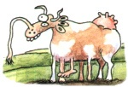
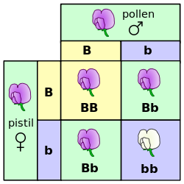
Mendelian recessives are exposed by inbreeding
Classical model of inheritance
One locus, typically with two alleles
Often exhibit complete dominance
e.g., Mendel’s experiments
Source: The Far Side.
Source: Wikimedia.

Slide 41
Known genetic defects in US Holsteins
Haplo- Type | Functional/Gene name | BTA chromosome | Location (Mbp) | Haplotype frequency (%) | Timing¹
HCD | Cholesterol deficiency/APOB | 11 | 78.0 | 0.34 | W
HH0 | Brachyspina/FANCI | 21 | 21.2 | 0.28 | E,B
HH1 | APAF1 | 5 | 63.2 | 0.40 | E
HH2 | IFT80 | 1 | 107.1 | 0.68 | E
HH3 | SMC2 | 8 | 95.4 | 0.65 | E
HH4 | GART | 1 | 1.3 | 0.09 | E
HH5 | TFB1M | 9 | 91.28– 91.9 | 2.50 | E
HH6 | SDE2 | 16 | 29.0 | 1.14 | W
HHB | BLAD/ITGB2 | 1 | 145.1 | 0.03 | W
HHC | CVM/SLC35A3 | 3 | 43.4 | 0.25 | E,B
HHD | DUMPS/UMPS | 1 | 69.8 | 0.00 | E
HHM | Mule foot/LRP4 | 15 | 77.7 | 0.00 | B
HMW | Muscle weakness/CACNA1S | 16 | 79.6 | 2.04 | B
¹Timing of embryonic loss/calf death for homozygous animals: B = calf death at/shortly after birth,
E = embryonic loss/abortion, W = calf death weeks/months after birth (Cole et al., 2018).

Slide 42
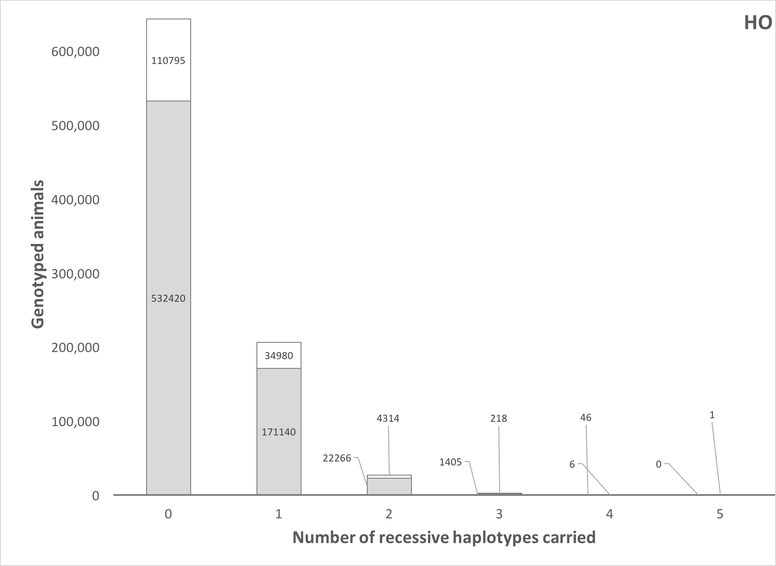
How many defects do individuals carry?
Source: Cole et al. (2016).

Slide 43
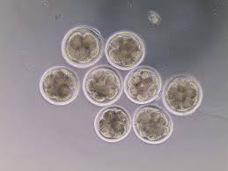
Validation of candidate variants
Cell biology research in large mammals is very expensive
Candidate genes for early embryonic losses not always validated in the laboratory
Targeted knockouts can be used to validate candidates for early embryonic losses
Relatively fast and cost-effective
Source: University of Florida (2013).

Slide 44
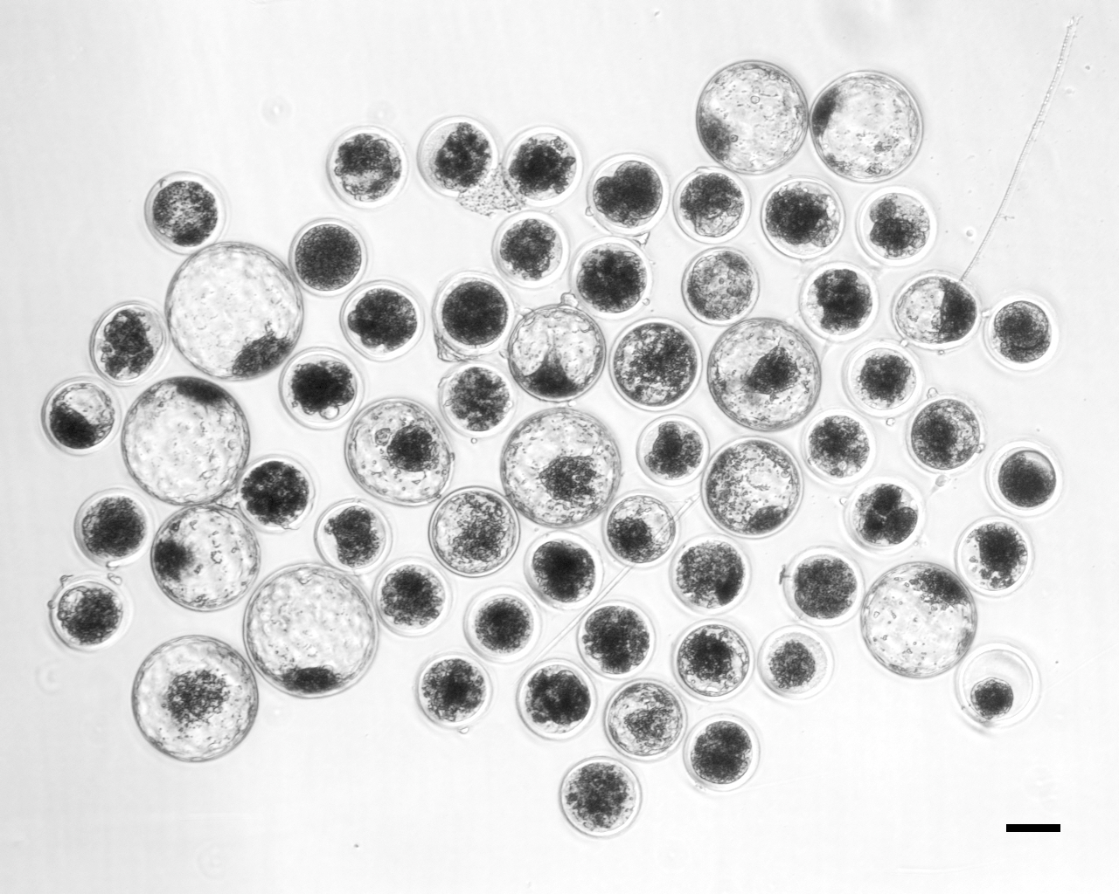
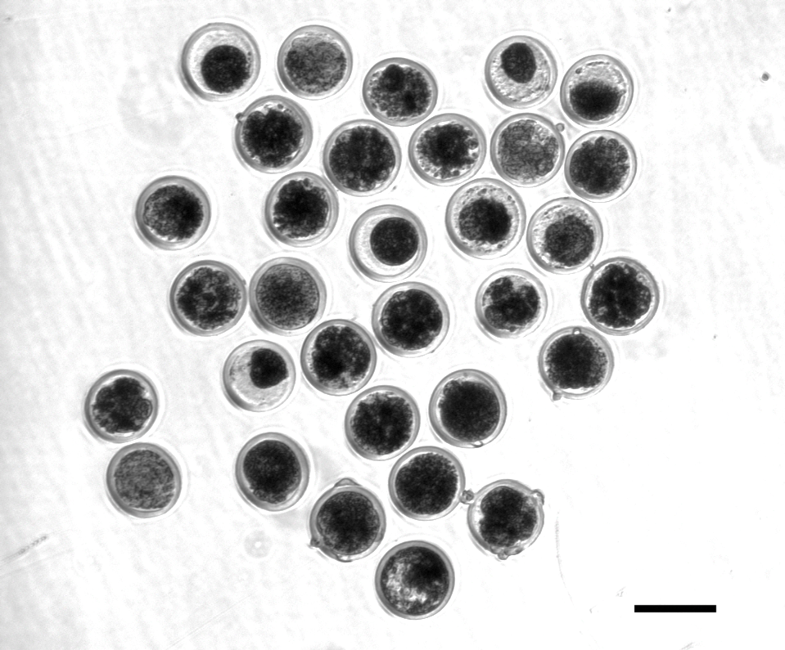
HH2 candidate confirmed with functional validation
Control embryos injected with only Cas-9 (left)
A frameshift in IFT80 at 107,172,615 bp (p.Leu381fs) disrupts wnt and hedgehog signaling, and is responsible for the death of homozygous embryos
A SNP will track the causal mutation
Cole et al. (2022)
Treatment embryos injected with Cas-9 and IFT80 exon 2 guide RNA (right)

Slide 45
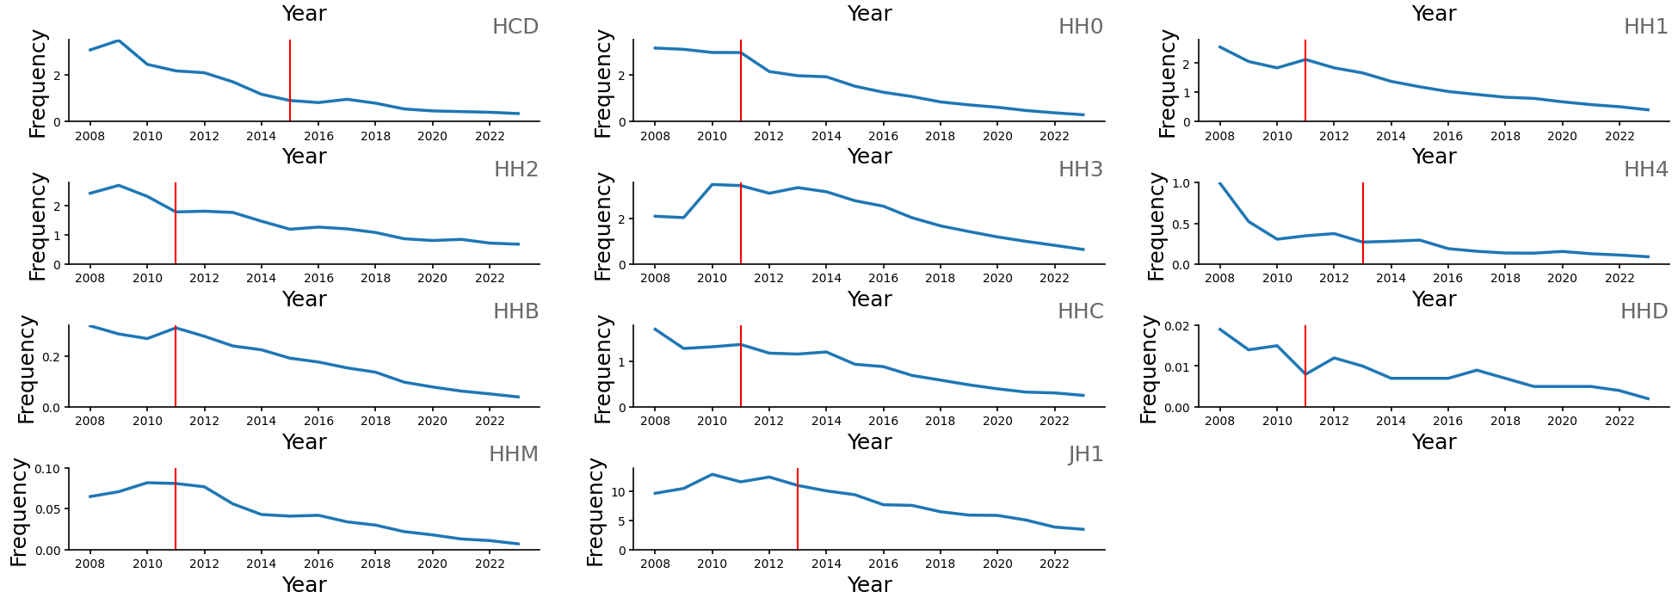
Changes in haplotype frequency
Cole et al. (2025)

Slide 46
Estimated cost of genetic load
Cole et al. (2016; 2025) estimated annual losses of at least ~$4.1 million due to known recessives, a substantial reduction over the last decade from an estimated $10.7 million.
Average losses were $4.34, $0.17, $0.32, and $0.81 in Ayrshire, Brown Swiss, Holstein, and Jersey, respectively.
This is the economic impact of genetic load as it affects fertility and perinatal mortality.
Actual losses are likely to be higher.

Slide 47
Is the number of defects increasing?
MacArthur et al. (2012) estimated that human genomes contain ~100 loss-of-function mutations, and ~20 completely inactivated genes
The mutations are there even if we have not identified them yet
  Example: HH6, mutation in SDE2 (Fritz et al., 2018)
Our detection methods are improving as our technology improves
New mutations do occur, but they are very rare

Slide 48
Rates of detection have changed
Cole et al. (2025, in press)

Slide 49
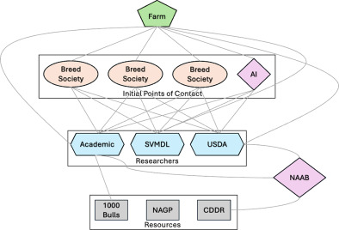
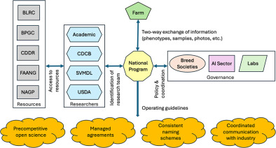
Population management isn’t easy
Current Situation
Proposed Future Structure
Cole et al. (2025, in press)

Slide 50
Conclusion

Slide 51
Are we concerned about the wrong thing?
“Selection, however - in marked contrast to its effectiveness in changing average merit - is a very feeble tool for changing homozygosity, except under the very simplest genetic situations…” (Lush, 1945)
“When the pure breeds finally reach equilibrium between the production of heterozygosis by mutations and the loss of heterozygosis because the effective number of animals in the breed is small, it is possible that the pure breed may support only a few scores of unfixed loci.” (Lush, 1945)

Slide 52
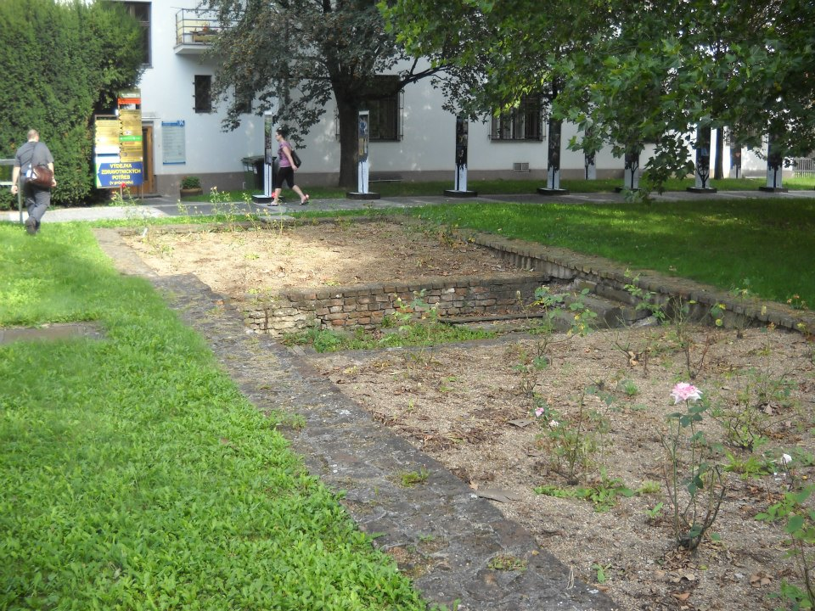
Questions?
Foundation of Gregor Mendel’s greenhouse, Brno, Czech Republic.

Slide 53
References
Antonios, S., S.T. Rodríguez-Ramilo, A. Legarra, J.-M. Astruc, L. Varona, and Z.G. Vitezica. 2025. Genetic inbreeding load and its individual prediction for milk yield in French dairy sheep. Genet. Sel. Evol. 57:1. https://doi.org/10.1186/s12711-024-00945-z.
Ayesiga, S.B., P. Rubaihayo, B.M. Oloka, I.O. Dramadri, R. Edema, and J.P. Sserumaga. 2023. Genetic variation among tropical maize inbred lines from NARS and CGIAR breeding programs. Plant Mol. Biol. Rep. 41:209–217. https://doi.org/10.1007/s11105-022-01358-2.
https://doi.org/10.2527/2005.835992x.
Cole, J.B. 2024. Perspective: Can we actually do anything about inbreeding? J. Dairy Sci. 107:643–648. https://doi.org/10.3168/jds.2023-23958.
Cole, John B., Christine F. Baes, Sophie A.E. Eaglen, Thomas J. Lawlor, Christian Maltecca, M. Sofía Ortega, and Paul M. VanRaden. 2025. Invited Review: Management of genetic defects in dairy cattle populations. J. Dairy Sci. (In press.) https://doi.org/10.3168/jds.2024-26035.
Cole, J.B., D.E. Franke, and E.A. Leighton. 2004. Population structure of a colony of dog guides. J. Anim. Sci. 82:2906–2912. https://doi.org/10.2527/2004.82102906x.

Slide 54
References (cont’d)
Cole, J.B., D.J. Null, and P.M. VanRaden. 2016. Phenotypic and genetic effects of recessive haplotypes on yield, longevity, and fertility. J. Dairy Sci. 99: 7274–7288. https://doi.org/10.3168/jds.2015-10777.
Cole, J.B., and P.M. VanRaden. 2011. Use of haplotypes to estimate Mendelian sampling effects and selection limits. J. Anim. Breed. Genet. https://doi.org/10.1111/j.1439-0388.2011.00922.x.
D’Ambrosio, J., F. Phocas, P. Haffray, A. Bestin, S. Brard-Fudulea, C. Poncet, E. Quillet, N. Dechamp, C. Fraslin, M. Charles, and M. Dupont-Nivet. 2019. Genome-wide estimates of genetic diversity, inbreeding and effective size of experimental and commercial rainbow trout lines undergoing selective breeding. Genet. Sel. Evol. 51:26. https://doi.org/10.1186/s12711-019-0468-4.
Goszczynski, D.E., H. Cheng, S. Demyda-Peyrás, J.F. Medrano, J. Wu, and P.J. Ross. 2018. In vitro breeding: application of embryonic stem cells to animal production. Biol. Reprod. https://doi.org/10.1093/biolre/ioy256.
Howard, J.T., J.E. Pryce, C. Baes, and C. Maltecca. 2017. Invited review: Inbreeding in the genomics era: Inbreeding, inbreeding depression, and management of genomic variability. J. Dairy Sci. 100:6009–6024. https://doi.org/10.3168/jds.2017-12787.

Slide 55
References (cont’d)
Johnsson, M., R.C. Gaynor, J. Jenko, G. Gorjanc, D.-J. de Koning, and J.M. Hickey. 2019. Removal of alleles by genome editing (RAGE) against deleterious load. Genet. Sel. Evol. 51:14. https://doi.org/10.1186/s12711-019-0456-8.
Macedo, F.L., O.F. Christensen, and A. Legarra. 2021. Selection and drift reduce genetic variation for milk yield in Manech Tête Rousse dairy sheep. JDS Comm. 2:31–34. https://doi.org/10.3168/jdsc.2020-0010.
Leroy, G. 2014. Inbreeding depression in livestock species: review and meta‐analysis. Anim. Genet. 5:618–628. https://doi.org/10.1111/age.12178.
Lozada-Soto, Emmanuel A., Christian Maltecca, Jicai Jiang, John B. Cole, Paul VanRaden, and Francesco Tiezzi. 2022. Genomic characterization of autozygosity and recent inbreeding trends in all major breeds of US dairy cattle. J. Dairy Sci. 105:8956-8971. https://doi.org/10.3168/jds.2022-22116.
Lozada-Soto, E.A., C. Maltecca, D. Lu, S. Miller, J.B. Cole, and F. Tiezzi. 2021. Trends in genetic diversity and the effect of inbreeding in American Angus cattle under genomic selection. Genet. Sel. Evol. 53:50. https://doi.org/10.1186/s12711-021-00644-z.

Slide 56
References (cont’d)
Lush, J.L. 1945. Animal Breeding Plans. 2nd ed. Iowa State College Press, Ames, IA.
McParland, S., J.F. Kearney, M. Rath, and D.P. Berry. 2007. Inbreeding trends and pedigree analysis of Irish dairy and beef cattle populations. J. Anim. Sci. 85:322–331. https://doi.org/10.2527/jas.2006-367.
Nicholas, F.W., and C. Smith. 1983. Increased rates of genetic change in dairy cattle by embryo transfer and splitting. Anim. Prod. 36:341–353. https://doi.org/10.1017/S0003356100010382.
Ortega, M. Sofía, Derek M. Bickhart, Kelsey N. Clark, Daniel J. Null, Jana L. Hutchison, Jennifer C. McClure, and John B. Cole. 2022. Truncation of IFT80 causes early embryonic loss in Holstein cattle associated with the HH2 haplotype. J. Dairy Sci. 105:9001–9011. https://doi.org/10.3168/jds.2022-21853.
Rafter, P., N. McHugh, T. Pabiou, and D.P. Berry. 2022. Inbreeding trends and genetic diversity in purebred sheep populations. animal 16:100604. https://doi.org/10.1016/j.animal.2022.100604.
Robertson, A. 1961. Inbreeding in artificial selection programmes. Genet.Res. 2:189–194. https://doi.org/10.1017/S0016672300000690.

Slide 57
References (cont’d)
Verrier, E., J.J. Colleau, and J.L. Foulley. 1993. Long-term effects of selection based on the animal model BLUP in a finite population. Theoret. Appl. Genetics 87:446–454. https://doi.org/10.1007/BF00215090.
Villanueva, B., A. Fernández, M. Saura, A. Caballero, J. Fernández, E. Morales-González, M.A. Toro, and R. Pong-Wong. 2021. The value of genomic relationship matrices to estimate levels of inbreeding. Genet. Sel. Evol. 53:42. https://doi.org/10.1186/s12711-021-00635-0.

